Slide 1


Recogito
Giovanni Pietro Vitali
giovannipietrovitali@gmail.com | giovannni.vitali@uvsq.fr
Université de Versailles Saint Quentin en Yvelines
Université Paris-Saclay

Slide 2
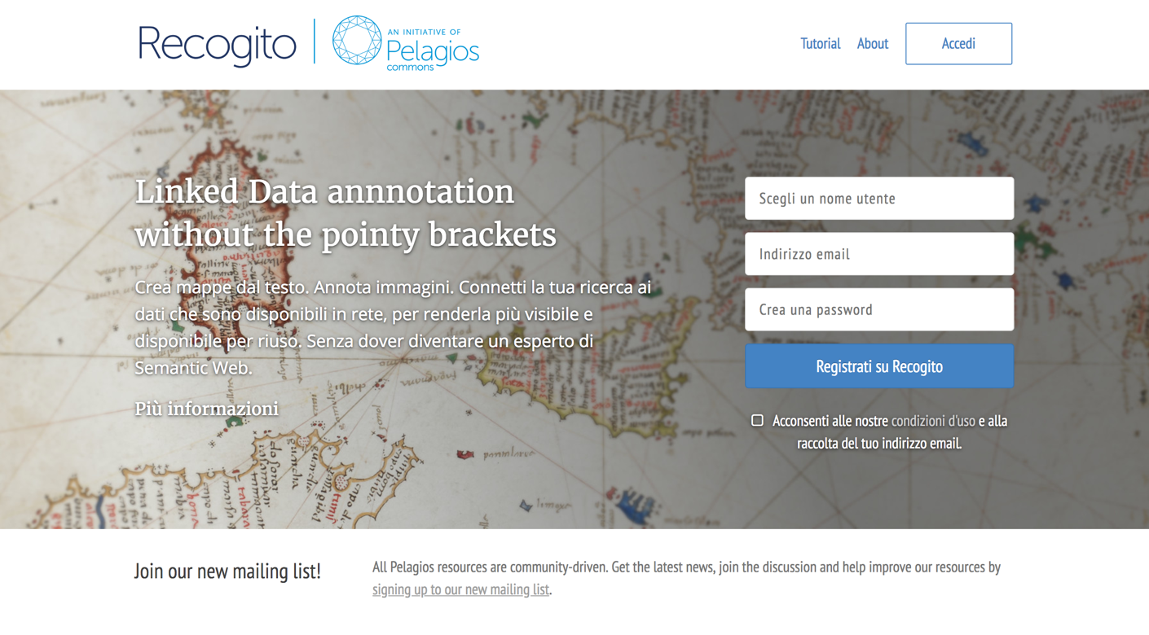
Recogito
Upload a corpus
Tag the places
Tag the people
Export and re-work the tables

Slide 3
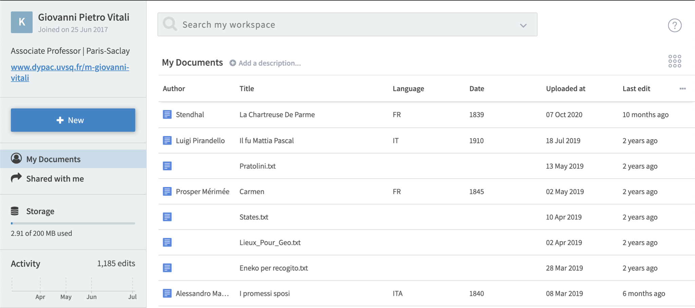
LIST OF DOCUMENTS
START HERE!

Slide 4
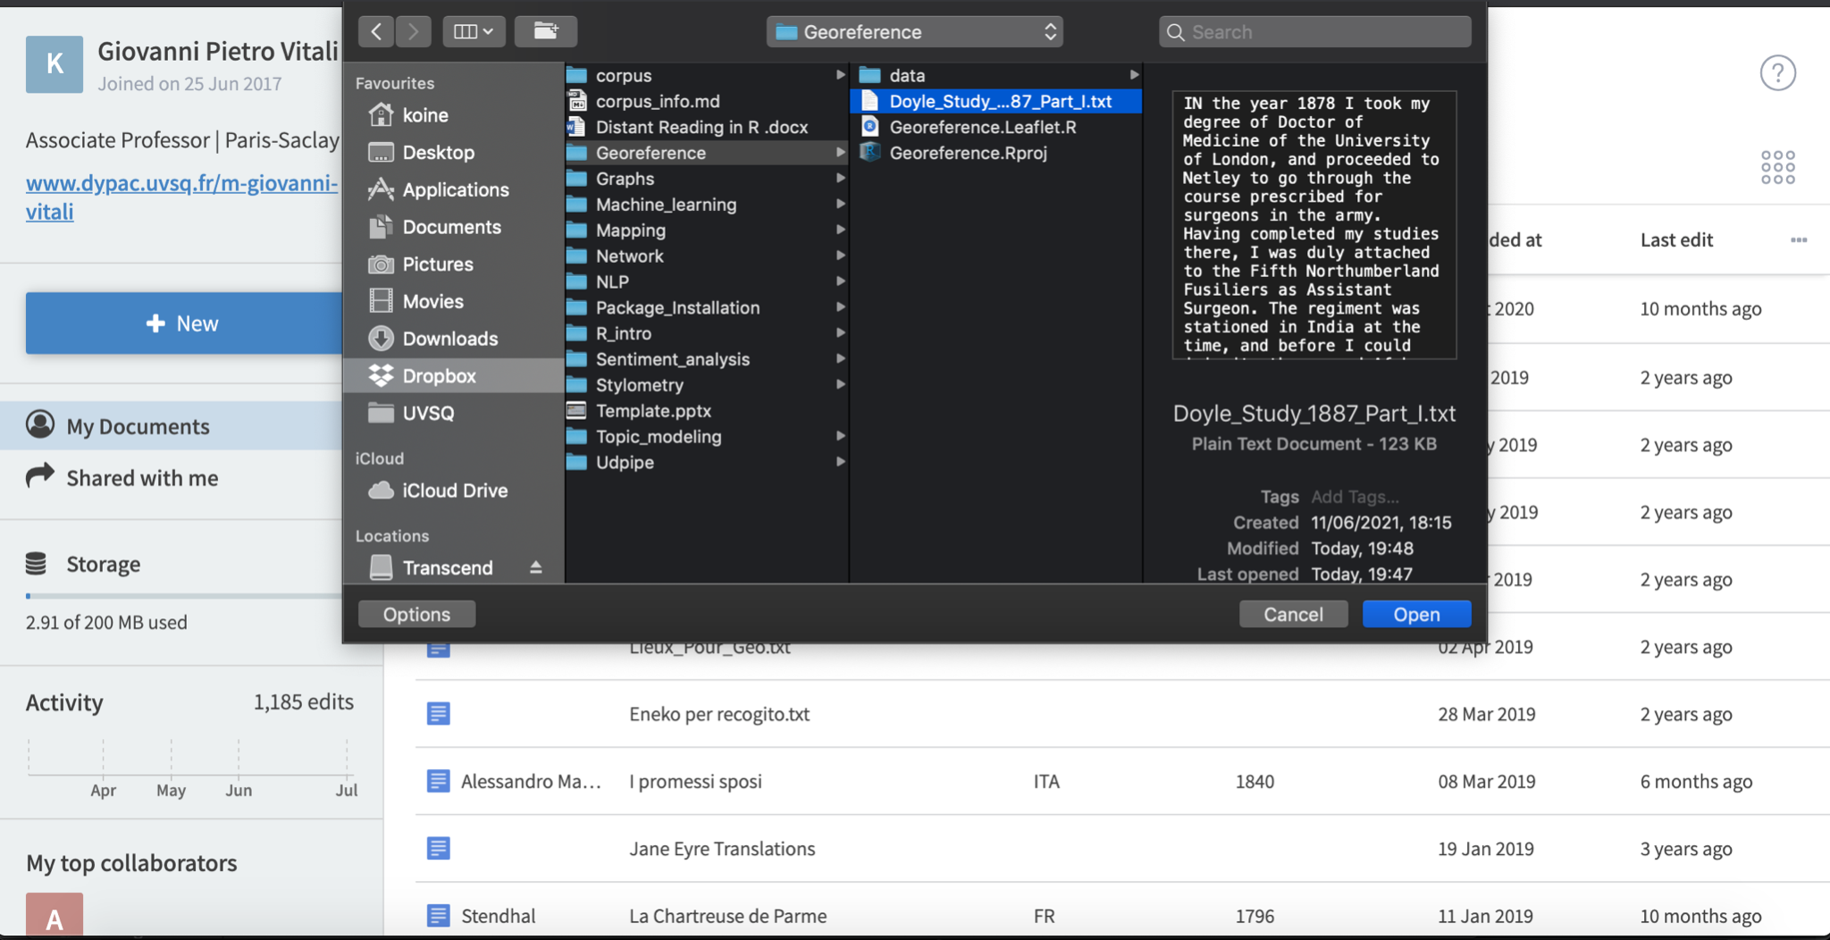
SELECT THE DOCUMENT

Slide 5
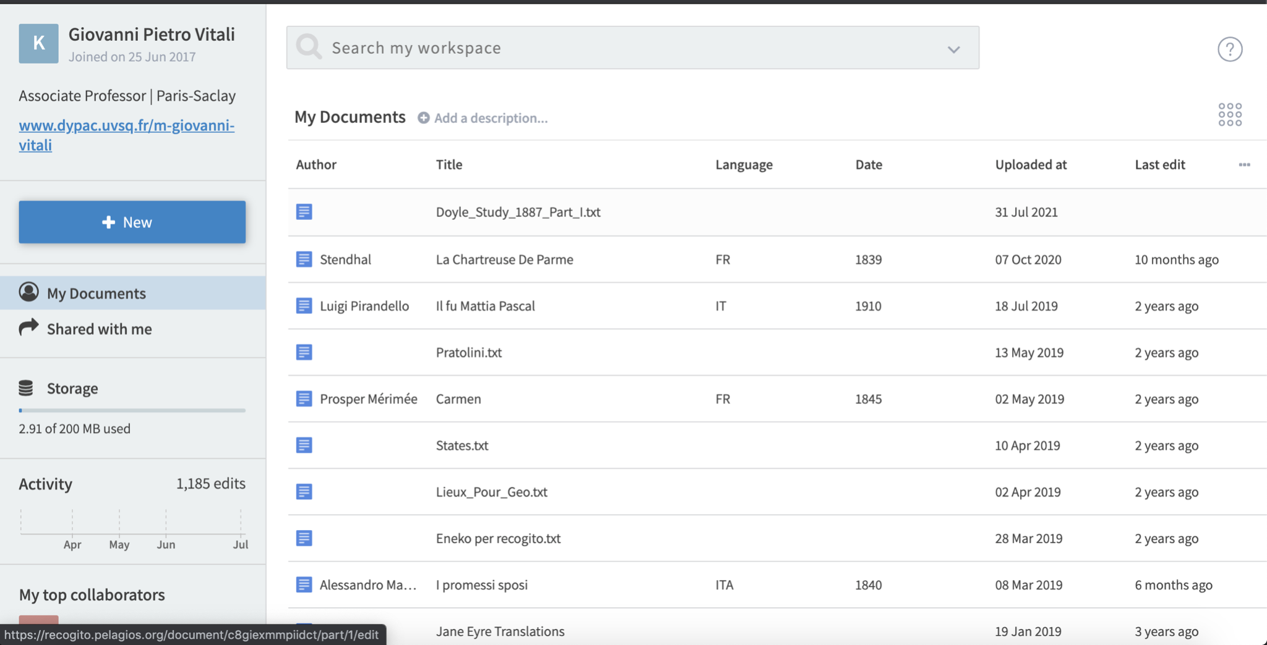

THE DOCUMENT APPEARS AT THE TOP OF THE LIST

Slide 6
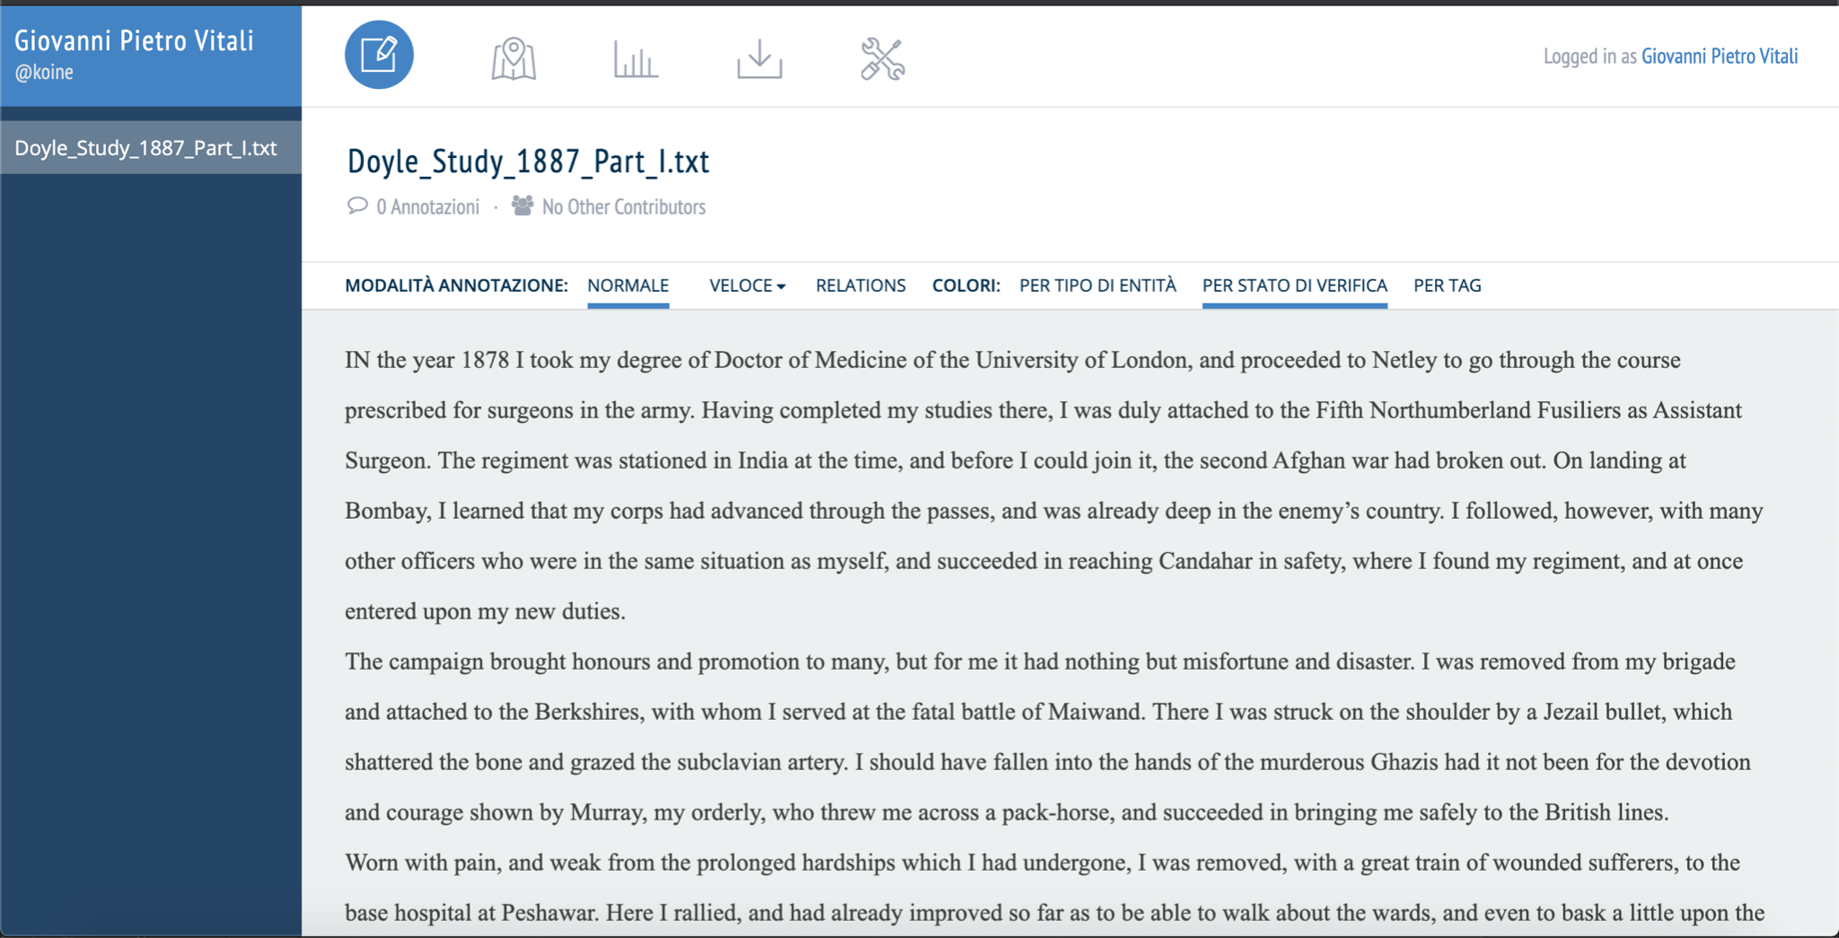
EDITOR
MAP VIEW
EXPORT
SETTINGS
STATS
ANNOTATION OPTIONS
TEXT BOX

Slide 7
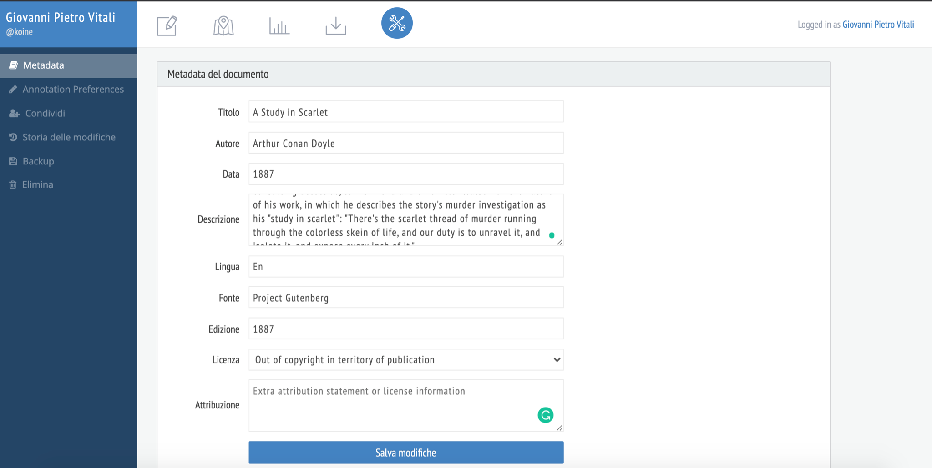
METADATA (FIRST THING TO ADD)

Slide 8
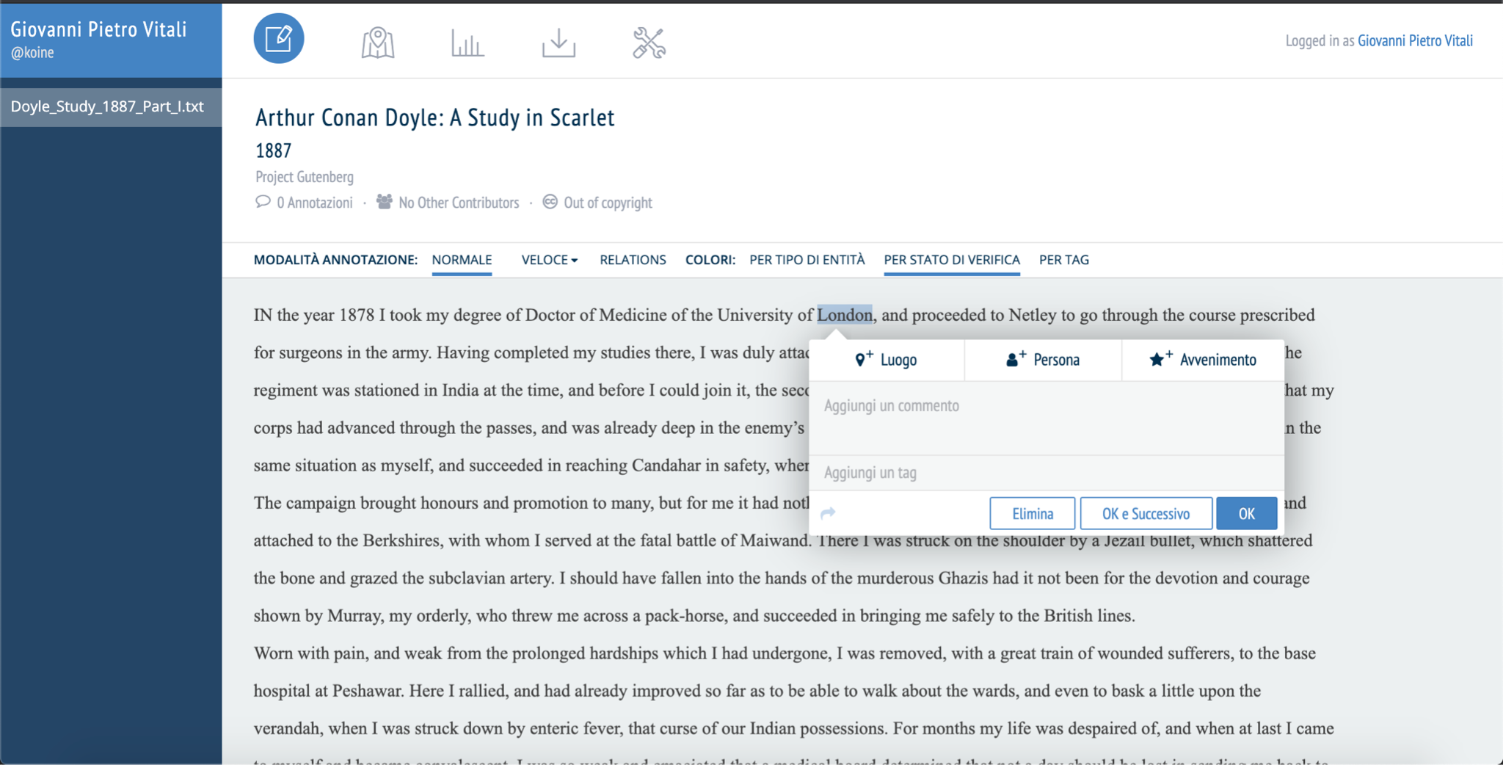
METADATA NOW APPEARS CORRECTLY ABOVE THE TEXT.
To annotate the text, select a part and a pop-up with options will appear.
PLACE
PEOPLE
EVENTS

Slide 9
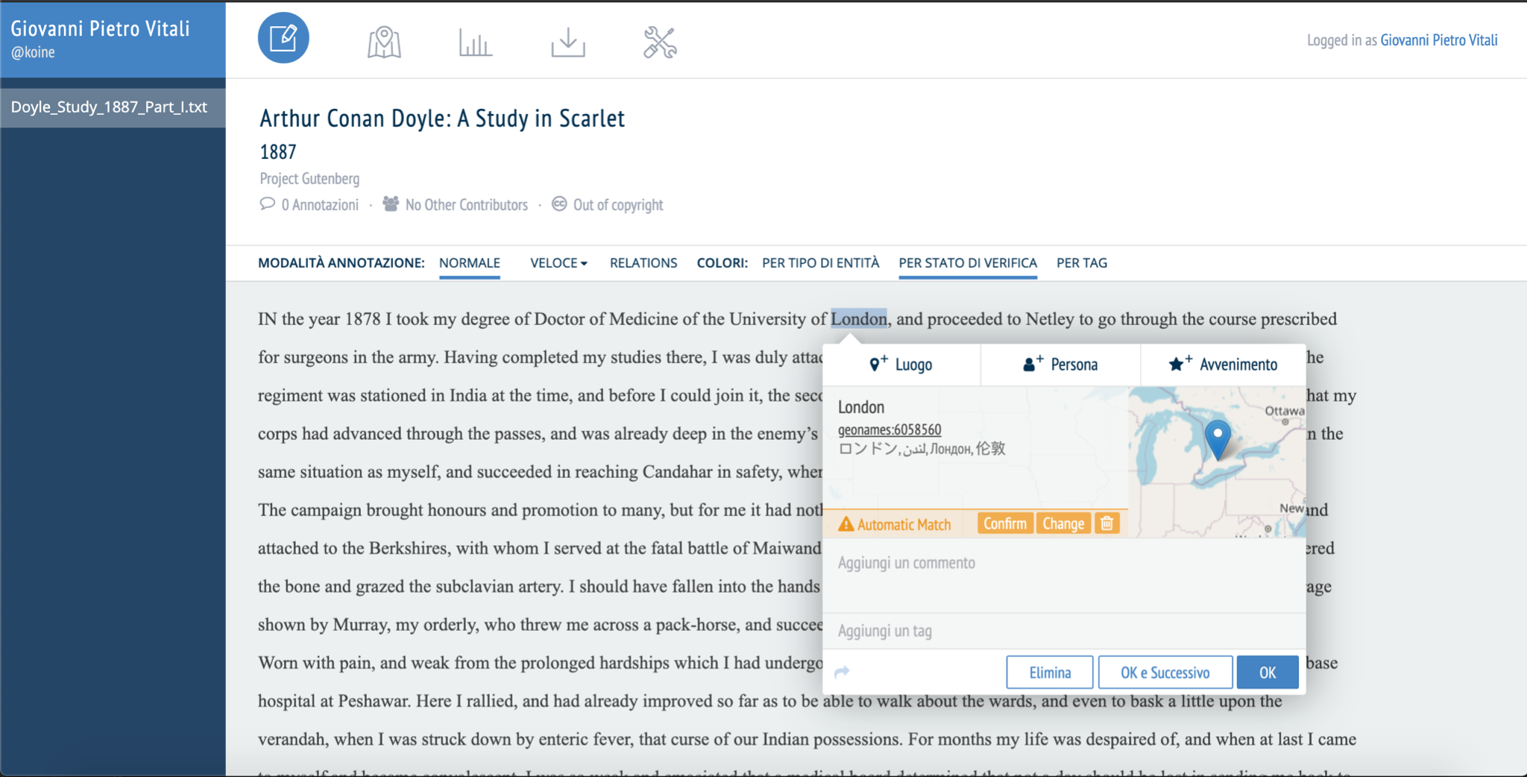
IT IS STRONGLY RECOMMENDED TO ALWAYS CHECK THE AUTOMATIC TAGGING OF PLACES

Slide 10
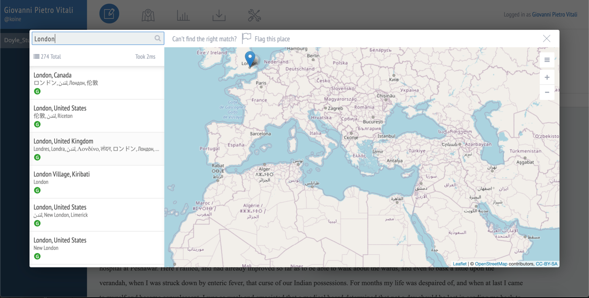
Click

Slide 11
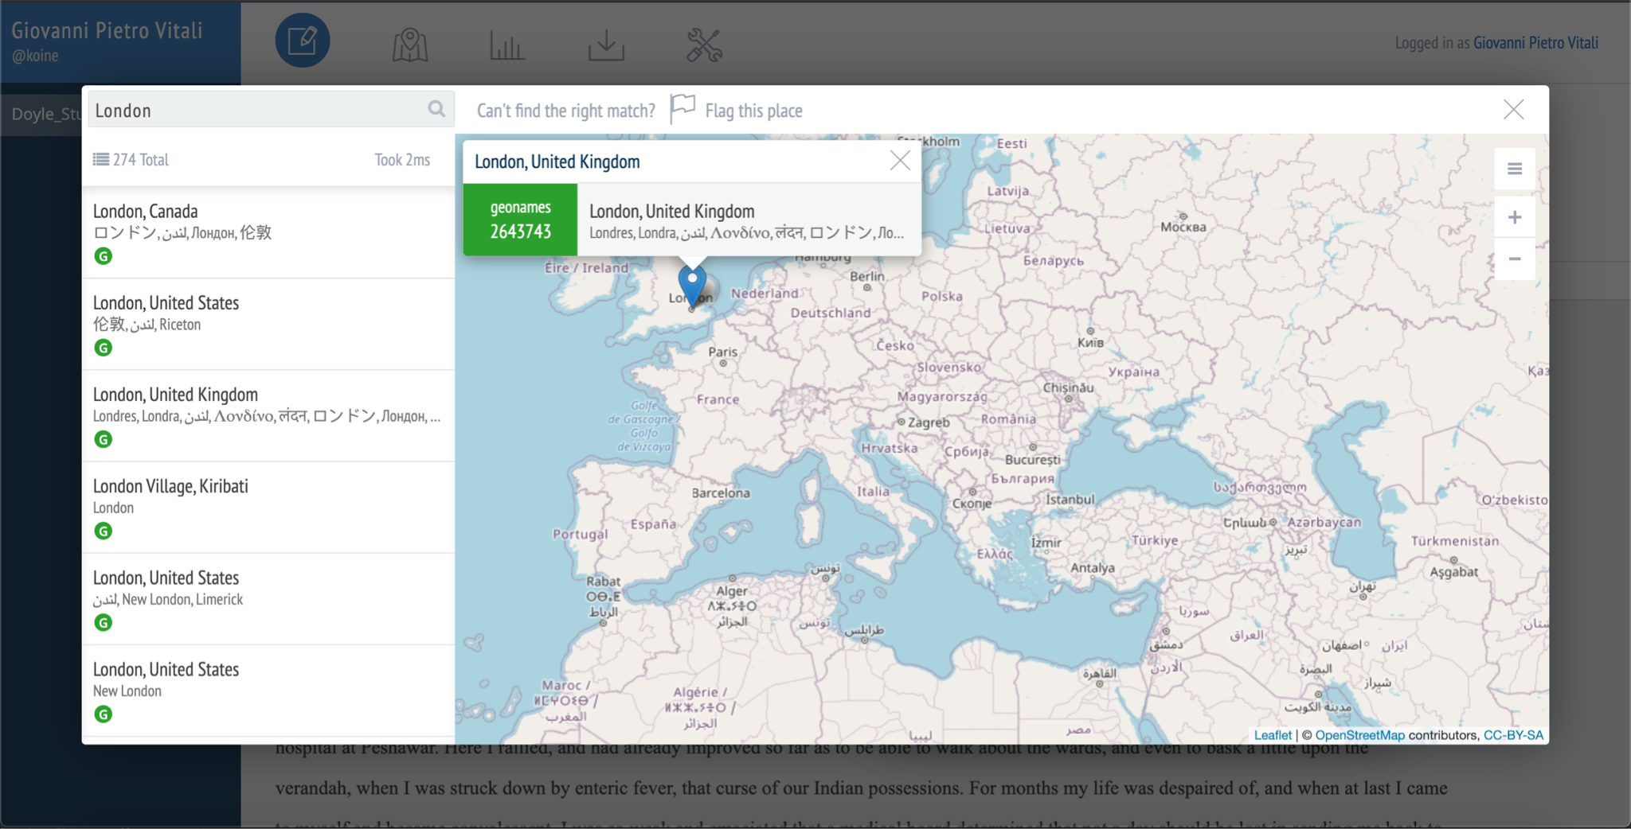
A POP-UP APPEARS ABOVE THE SELECTED LOCATION FOR CONFIRMATION.

Slide 12
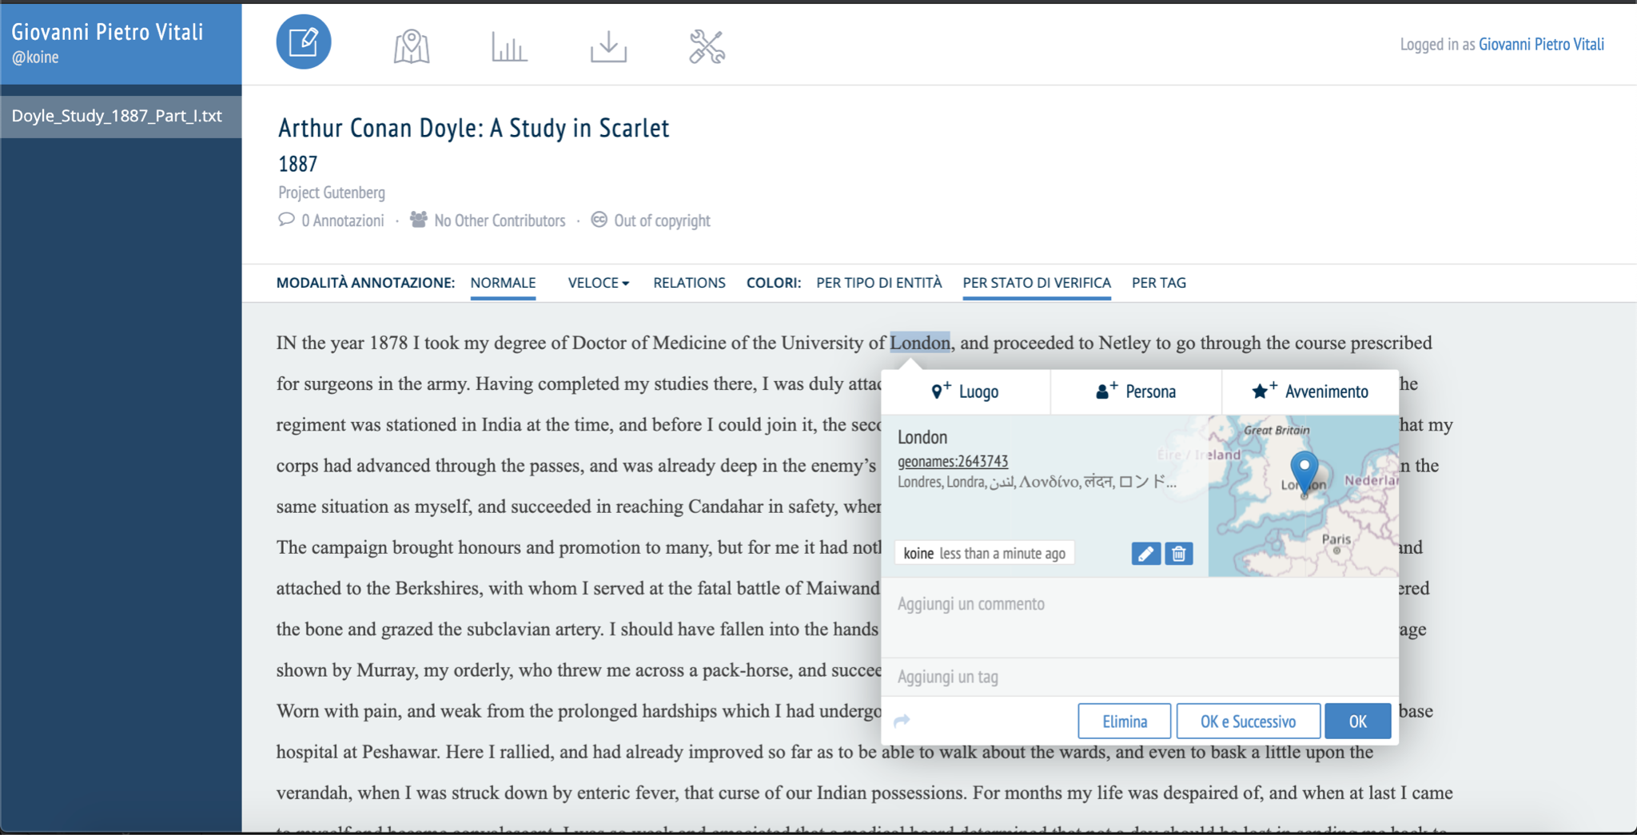
Click OK TO CONFIRM

Slide 13
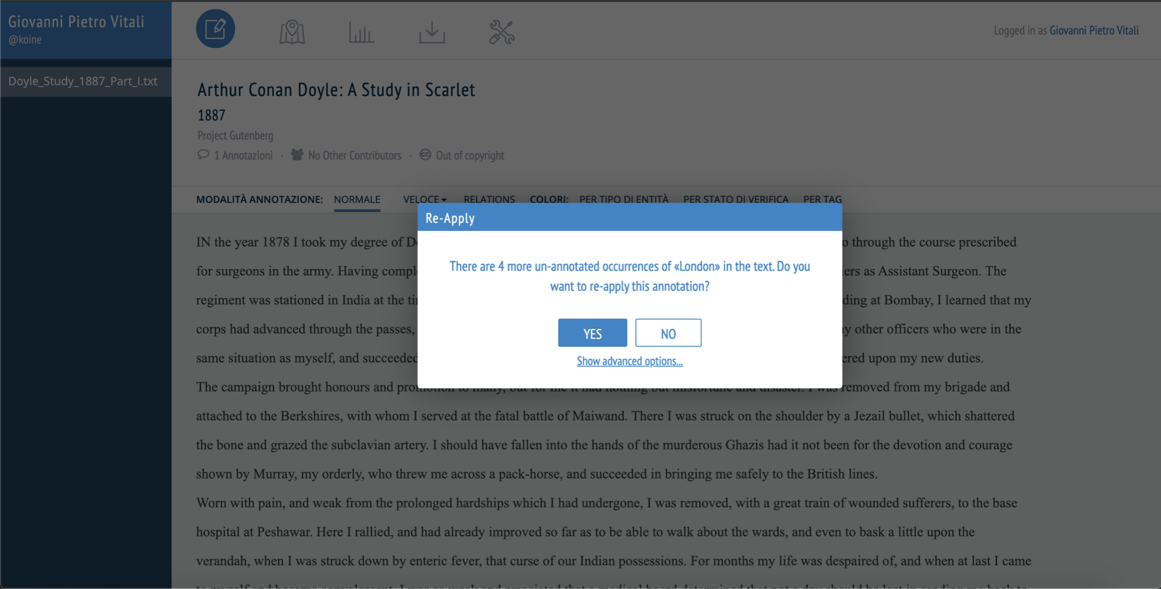
RECOGITO AUTOMATICALLY RECOGNISES AND TAGS OTHER OCCURRENCES OF THE TERM.

Slide 14
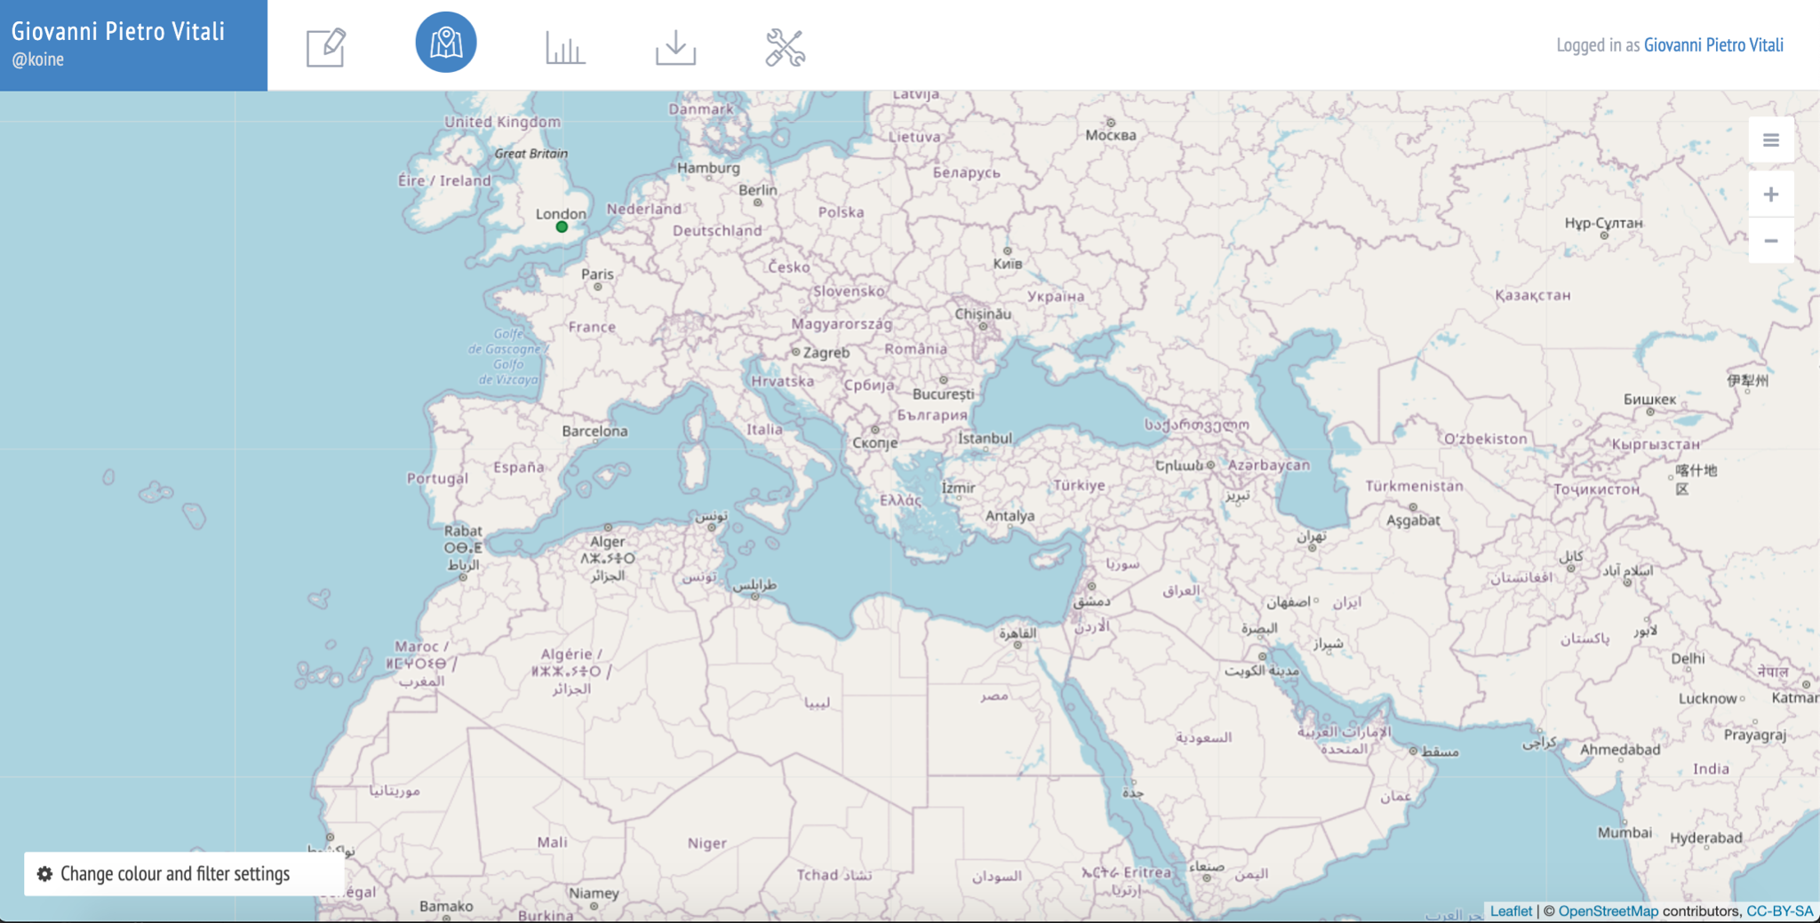
IN MAP VIEW THE PLACE APPEARS GEOLOCATED

Slide 15
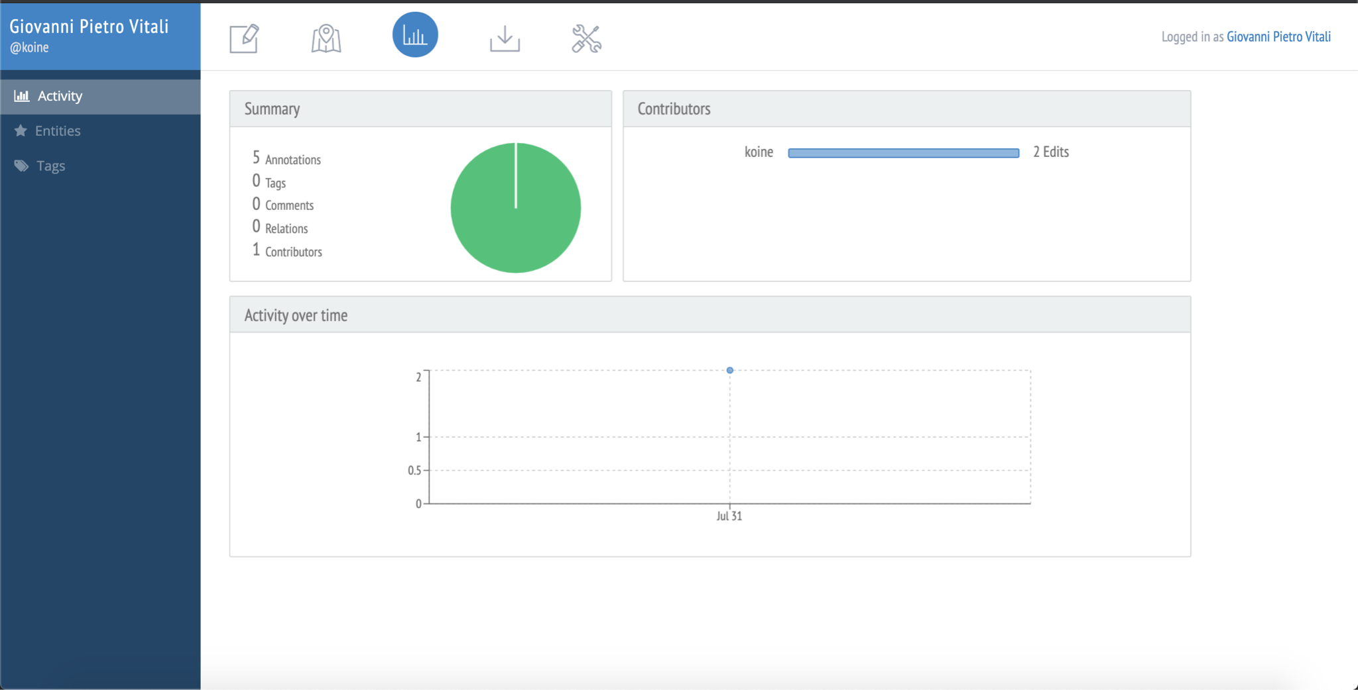
STATISTICS ALLOW YOU TO CHECK YOUR PERSONAL AND TEAM WORK ON THE DOCUMENT.

Slide 16
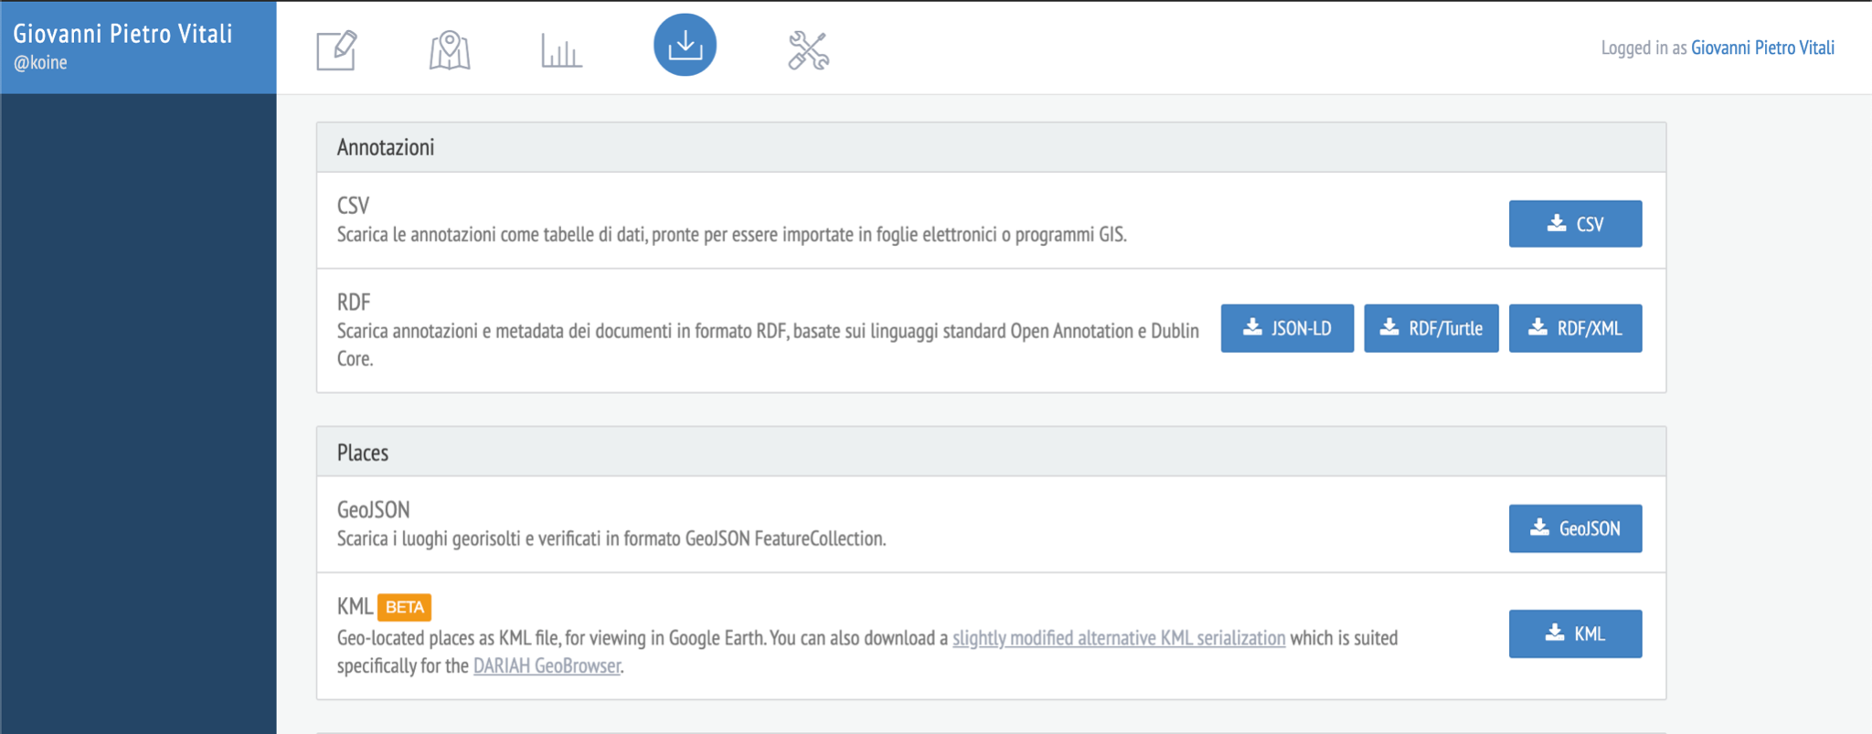
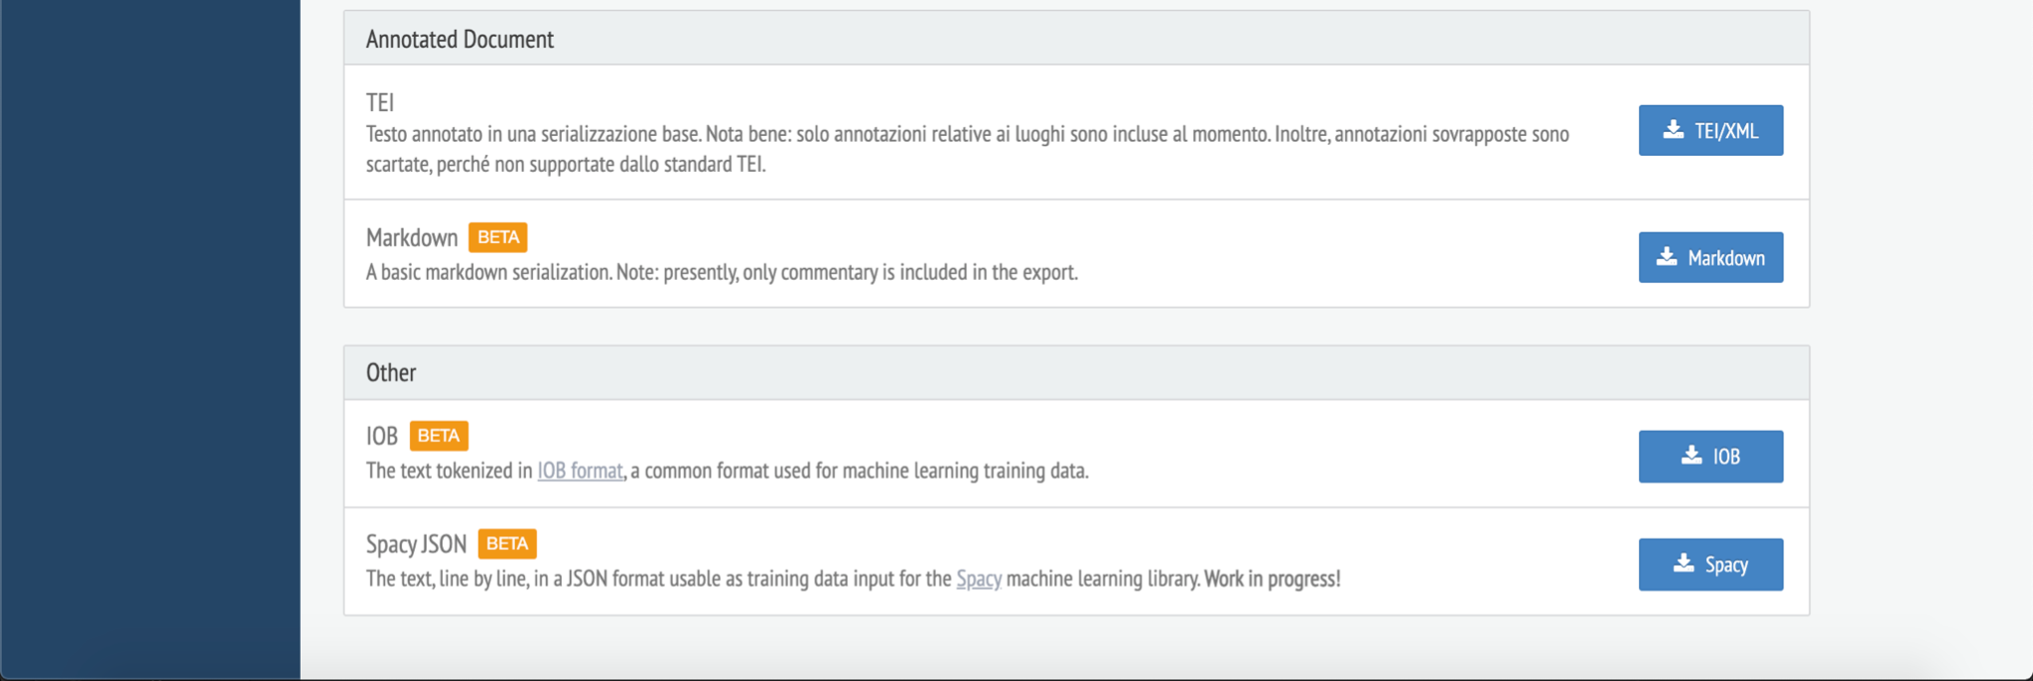
RECOGITO HAS MANY INTERESTING CONVERSION POSSIBILITIES

Slide 17

Exercise for Recogito: https://bit.ly/3uOlkMM

Slide 18
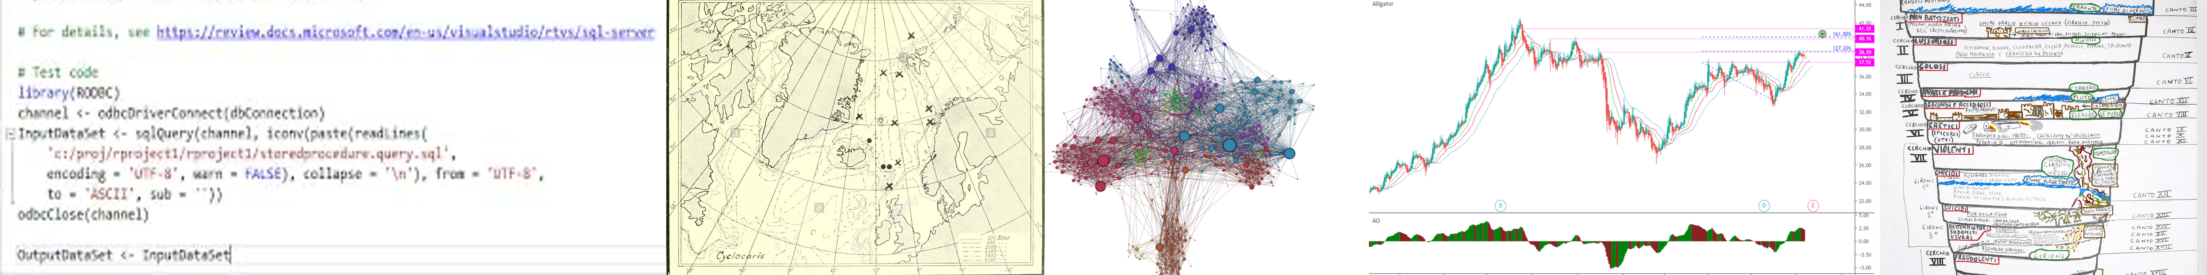
Recogito _end
Giovanni Pietro Vitali
giovannipietrovitali@gmail.com
https://github.com/digitalkoine
https://ucc-ie.academia.edu/GiovanniPietroVitali

